Slide 1
Minor Project Presentation
KAPPETA SRINIVAS REDDY (14115042)
KAVETI ANIRUDH REDDY (14115046)
TAGGI KISHORE (14115089)

Slide 2
Testing the performance of machine learning algorithms on bioinformatics data sets
Guided By:
Dr. Manu Vardhan
Assistant Professor
CSE, NIT Raipur

Slide 3
ABSTRACT
Gene expression data helps in advancement of clinical study. The sample dimension of gene expression data is very less than gene dimension of gene expression data. This mismatch in data causes difficult to use this data for classification and prediction. Only small number of genes are strongly correlated in this data. This causes the need for selection of features. We use different feature selection algorithms to select those genes required for efficient classification. We also use genetic algorithms in order to select the genes. Finally accuracy scores are calculated for different number of features of this data using different classifiers such as SVM (Support Vector Machines), RF (Random Forest), DT (Decision Tree) etc.

Slide 4
Box plots are drawn to display the distribution of accuracy of different classifiers and also error bars to know how precise the measurement is, or conversely, how far from the reported value the true (error free) value might be.
We used feature selection algorithms like F score, ReliefF etc. and also genetic feature selection algorithm to help us in ranking and selecting the genes and they are also capable of identifying the most relevant genes responsible for diseases like leukemia, colon tumor, lung cancer, Small, round blue cell tumors (SRBCT) , prostate cancer etc.

Slide 5
INTRODUCTION
Bioinformatics datasets is the biological data of life sciences info.
Also called as ‘Gene Data’
Microarray database containing microarray gene expression data
Used SRBCT, Prostate Cancer and Lung Cancer
Applied feature selection algorithms to reduce dimensionality and redundancy
Gene selection is done to reduce irrelevant, redundant and noisy expressions

Slide 6
CONTD…
Process of Feature Selection
Determining Search Direction
Determining Search Strategy
Determining Evaluation Criteria (filter and hybrid)
Defining Stopping Criteria
Validating the Result
Used ReliefF, F-score, Low Variance, Fisher Score
Used k-fold Cross Validation

Slide 7
CONTD…
Genetic Algorithm
Search based algorithm
Used to find near Optimal Solutions
Using Crossover and mutation
This process is repeated over various generations
Optimal features subset is selected using a Fitness function

Slide 8
WORKING METHODOLOGY
Flowchart representing the feature selection process
Input Data
Feature Selection
Classification
Result
Analysis

Slide 9
CONTD…
Flowchart for feature selection using Genetic Algorithm
Population Initialization
Parent Selection
Crossover
Terminate and Return Best
Mutation
Best solution selection
Loop until no. of generations reached
Initialize a better population using local search
Local search over crossover
Local search after mutation

Slide 10
SOFTWARES AND LIBRARIES USED
Python 2.7
Libraries:
Scikit-learn
Matplotlib
Scikit-feature
Sklearn-genetic

Slide 11
DATASETS
SRBCT Dataset
Diagnostic Classes: 4
Ewing’s sarcoma (EWS): 29 examples (34.9%)
Burkitt’s lymphoma (BL): 11 examples (13.3%)
Neuroblastoma (NB): 18 examples (21.7%)
Rhabdomyosarcoma (RMS): 25 examples (30.1%)
Number of genes: 2308
Number of samples: 83

Slide 12
DATASETS
Prostate Cancer:
Diagnostic Classes: 2
Androgen dépendent tumour (dépendent): 10 examples (50.0%)
Androgen-independent tumour (independent): 10 examples (50.0%)
Number of genes: 10510
Number of samples: 102

Slide 13
DATASETS
Lung Cancer:
Diagnostic Classes: 5
Squamous cell carcinoma (Squamous): 20 examples (9.85%)
Adenocarcinoma (Adenocarcinoma): 17 examples (8.37%)
Normal lung tissue (Normal): 21 examples (10.34%)
Coid: 6 samples (2.95%)
SMCL: 139 examples (68.47%)
Number of genes: 12600
Number of samples: 203

Slide 14

SELECTING SUBSET OF FEATURES
Using ReliefF feature selection algorithm (Similarity Based)
Deals with noisy, incomplete, and multiclass dataset.

Slide 15

SELECTING SUBSET OF FEATURES
Using F-score feature selection algorithm (Statistical Based)
F scores of each features is calculated
Subset having lowest average validation error is chosen

Slide 16
SELECTING SUBSET OF FEATURES
Using Low Variance feature selection algorithm (Statistical Based)
Features are selected based on VarianceThreshold
Features having variance less than VarianceThreshold are ignored

Slide 17

SELECTING SUBSET OF FEATURES
Using Fisher Score feature selection algorithm (Similarity based)
Subset of features selected maximizes the lower bound of fisher score of each feature

Slide 18

CLASSIFICATION
Using Decision Tree classifier

Slide 19

CLASSIFICATION
Using Support Vector Machine classifier

Slide 20

CLASSIFICATION
Using Random Forest classifier

Slide 21

CLASSIFICATION
Using Bagging classifier

Slide 22
GENETIC ALGORITHM FEATURE SELECTION
Steps:
Obtain the data from any data source
Initialize the genetic algorithm with Logistic Regression
Fit the genetic algorithm with the given data.
Fitness values are calculated with Logistic Regression
The algorithm returns the selected features after running for number of generations.
This features are used to calculate the accuracy using different classifiers.

Slide 23
APPLYING GENETIC ALGORITHM ON DATASETS
Initialize the population and calculate the fitness value of each solution. More the size of population the optimal the solution will be.
Repeat the following steps until termination is reached.
Select the parent i.e., population with fitness values reaching the threshold.
Crossover the parents obtained in step 3 with probability (Pc) to obtain the offspring’s.
Mutate the offspring’s to generate the new population with probability (Pm).

Slide 24
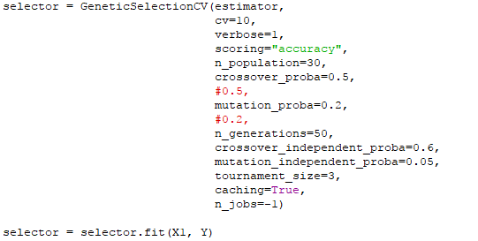
CONTD…
Select the best offspring’s based on fitness values.
If the fitness values are similar threshold values then exit otherwise go to step 2.

Slide 25
EXPERIMENTAL ANALYSIS

Slide 26
ACCURACY SCORES
SVM | Number of Features
Feature Selection Algorithm | 10 | 20 | 40 | 60 | 80 | 100
ReliefF | 0.81125 | 0.8275 | 0.860556 | 0.919881 | 0.946389 | 0.960317
F Score | 0.908056 | 0.935437 | 0.973333 | 0.9875 | 0.954167 | 0.974603
Fisher Score | 0.825714 | 0.950992 | 0.976389 | 0.930159 | 0.977778 | 1
Low Variance | 1 | 1 | 1 | 1 | 1 | 1
Accuracy scores of SRBCT dataset using SVM classifier

Slide 27
ACCURACY SCORES
Random Forest | Number of Features
Feature Selection Algorithm | 10 | 20 | 40 | 60 | 80 | 100
ReliefF | 0.795833 | 0.698373 | 0.828095 | 0.943056 | 0.968889 | 0.955278
F Score | 0.962103 | 00954167 | 0.988889 | 1 | 0.99 | 0.931667
Fisher Score | 0.923333 | 0.960714 | 0.988889 | 0.976389 | 0.976389 | 0.988889
Low Variance | 0.893373 | 0.913214 | 0.945556 | 0.946548 | 0.946548 | 0.94
Accuracy scores of SRBCT dataset using Random Forest classifier

Slide 28
ACCURACY SCORES
Decision Tree | Number of Features
Feature Selection Algorithm | 10 | 20 | 40 | 60 | 80 | 100
ReliefF | 0.651865 | 0.722262 | 0.793254 | 0.849484 | 0.893889 | 0.871548
F Score | 0.899325 | 0.875833 | 0.815437 | 0.821865 | 0.875317 | 0.810992
Fisher Score | 0.902381 | 0.886111 | 0.840833 | 0.786667 | 0.852937 | 0.805595
Low Variance | 0.801944 | 0.801825 | 0.798651 | 0.830595 | 0.78131 | 0.808651
Accuracy scores of SRBCT dataset using Decision Tree classifier

Slide 29
ACCURACY SCORES
Bagging | Number of Features
Feature Selection Algorithm | 10 | 20 | 40 | 60 | 80 | 100
ReliefF | 0.637381 | 0.774048 | 0.9025 | 0.942778 | 0.913889 | 0.976389
F Score | 0.931667 | 0.921944 | 0.940317 | 0.941111 | 0.9425 | 0.958333
Fisher Score | 0.921825 | 0.926389 | 0.964603 | 0.954603 | 0.93127 | 0.942778
Low Variance | 0.925992 | 0.948611 | 0.938611 | 0.924603 | 0.916667 | 0.938889
Accuracy scores of SRBCT dataset using Bagging classifier

Slide 30
ACCURACY SCORES
SVM | Number of Features
Feature Selection Algorithm | 10 | 20 | 40 | 60 | 80 | 100
ReliefF | 0.802727 | 0.832727 | 0.872727 | 0.883636 | 0.893636 | 0.911818
F Score | 0.822727 | 0.873636 | 0.921818 | 0.932727 | 0.912727 | 0.920909
Fisher Score | 0.843636 | 0.890909 | 0.9109 | 0.911818 | 0.921818 | 0.931818
Low Variance | 0.892727 | 0.900909 | 0.901818 | 0.911818 | 0.885455 | 0.880909
Accuracy scores of Prostate Tumour dataset using SVM classifier

Slide 31
ACCURACY SCORES
Random Forest | Number of Features
Feature Selection Algorithm | 10 | 20 | 40 | 60 | 80 | 100
ReliefF | 0.821818 | 0.87 | 0.893636 | 0.920909 | 0.901818 | 0.900909
F Score | 0.890909 | 0.900909 | 0.890909 | 0.883636 | 0.890909 | 0.883636
Fisher Score | 0.883636 | 0.881818 | 0.910909 | 0.902727 | 0.912727 | 0.920909
Low Variance | 0.783636 | 0.801818 | 0.862727 | 0.844545 | 0.813636 | 0.860909
Accuracy scores of Prostate Tumour dataset using Random Forest classifier

Slide 32
ACCURACY SCORES
Decision Tree | Number of Features
Feature Selection Algorithm | 10 | 20 | 40 | 60 | 80 | 100
ReliefF | 0.765455 | 0.813636 | 0.813636 | 0.843636 | 0.872727 | 0.882727
F Score | 0.822727 | 0.822727 | 0.843636 | 0.871818 | 0.814545 | 0.850909
Fisher Score | 0.842727 | 0.841818 | 0.871818 | 0.794545 | 0.805455 | 0.864545
Low Variance | 0.823636 | 0.851818 | 0.808182 | 0.852727 | 0.861818 | 0.783636
Accuracy scores of Prostate Tumour dataset using Decision Tree classifier

Slide 33
ACCURACY SCORES
Bagging | Number of Features
Feature Selection Algorithm | 10 | 20 | 40 | 60 | 80 | 100
ReliefF | 0.87 | 0.883636 | 0.851818 | 0.883636 | 0.920909 | 0.892727
F Score | 0.911818 | 0.91 | 0.883636 | 0.91 | 0.920909 | 0.890909
Fisher Score | 0.861818 | 0.892727 | 0.881818 | 0.902727 | 0.921818 | 0.920909
Low Variance | 0.862727 | 0.873636 | 0.902727 | 0.88 | 0.881818 | 0.882727
Accuracy scores of Prostate Tumour dataset using Bagging classifier

Slide 34
ACCURACY SCORES
SVM | Number of Features
Feature Selection Algorithm | 10 | 20 | 40 | 60 | 80 | 100
ReliefF | 0.634756 | 0.74858 | 0.864723 | 0.86126 | 0.882347 | 0.901855
F Score | 0.734691 | 0.790405 | 0.870637 | 0.914612 | 0.920759 | 0.93688
Fisher Score | 0.753757 | 0.791447 | 0.882266 | 0.910668 | 0.902118 | 0.887597
Low Variance | 0.941097 | 0.931642 | 0.93614 | 0.941645 | 0.9449 | 0.942359
Accuracy scores of Lung Cancer dataset using SVM classifier

Slide 35
ACCURACY SCORES
Random Forest | Number of Features
Feature Selection Algorithm | 10 | 20 | 40 | 60 | 80 | 100
ReliefF | 0.744165 | 0.817018 | 0.838471 | 0.8763 | 0.883669 | 0.888456
F Score | 0.800159 | 0.813158 | 0.857698 | 0.886335 | 0.883085 | 0.895675
Fisher Score | 0.823521 | 0.81627 | 0.862698 | 0.878258 | 0.897306 | 0.886659
Low Variance | 0.908045 | 0.891541 | 0.872612 | 0.916566 | 0.907028 | 0.896811
Accuracy scores of Lung Cancer dataset using Random Forest classifier

Slide 36
ACCURACY SCORES
Decision Tree | Number of Features
Feature Selection Algorithm | 10 | 20 | 40 | 60 | 80 | 100
ReliefF | 0.641584 | 0.79925 | 0.817302 | 0.818781 | 0.877306 | 0.847977
F Score | 0.783922 | 0.768396 | 0.829211 | 0.816349 | 0.838968 | 0.858268
Fisher Score | 0.782381 | 0.802728 | 0.833435 | 0.813093 | 0.797787 | 0.873348
Low Variance | 0.872569 | 0.897627 | 0.884358 | 0.881736 | 0.900877 | 0.868042
Accuracy scores of Lung Cancer dataset using Decision Tree classifier

Slide 37
ACCURACY SCORES
Bagging | Number of Features
Feature Selection Algorithm | 10 | 20 | 40 | 60 | 80 | 100
ReliefF | 0.709987 | 0.853604 | 0.886335 | 0.879048 | 0.916072 | 0.89223
F Score | 0.803822 | 0.852262 | 0.858233 | 0.891097 | 0.871591 | 0.896448
Fisher Score | 0.817761 | 0.826206 | 0.852256 | 0.885837 | 0.898095 | 0.896956
Low Variance | 0.907302 | 0.911642 | 0.926165 | 0.905599 | 0.930163 | 0.932576
Accuracy scores of Lung Cancer dataset using Bagging classifier

Slide 38
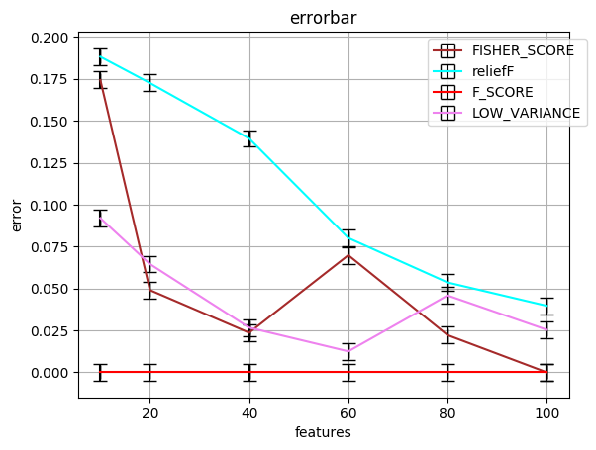
ERROR BARS OF FEATURE SELECTION ALGORITHMS
Error bar of feature selection algorithms using SVM classifier on SRBCT dataset

Slide 39
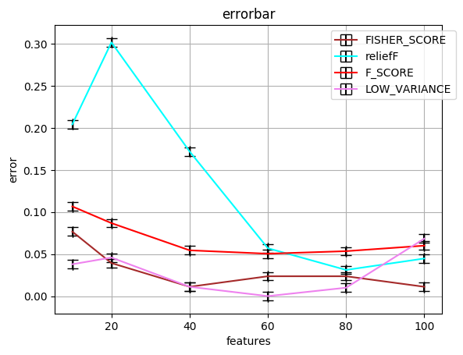
ERROR BARS OF FEATURE SELECTION ALGORITHMS
Error bar of feature selection algorithms using Random Forest classifier on SRBCT dataset

Slide 40
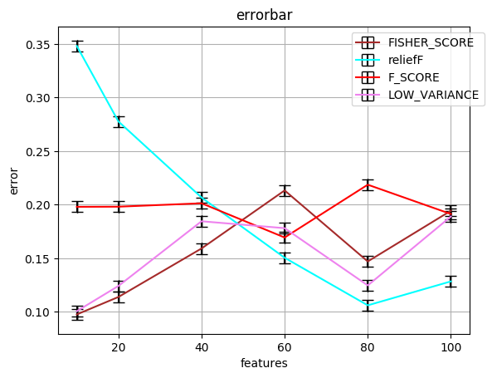
ERROR BARS OF FEATURE SELECTION ALGORITHMS
Error bar of feature selection algorithms using Decision Tree classifier on SRBCT dataset

Slide 41
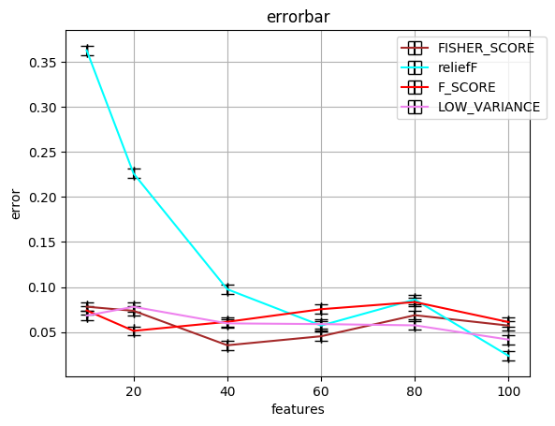
ERROR BARS OF FEATURE SELECTION ALGORITHMS
Error bar of feature selection algorithms using Bagging classifier on SRBCT dataset

Slide 42
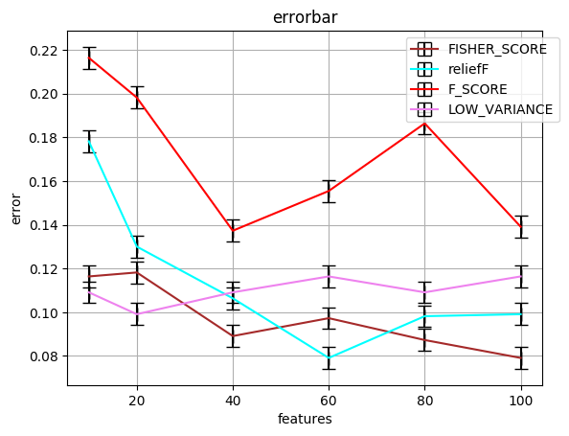
ERROR BARS OF FEATURE SELECTION ALGORITHMS
Error bar of feature selection algorithms using SVM classifier on Prostate Tumour dataset

Slide 43
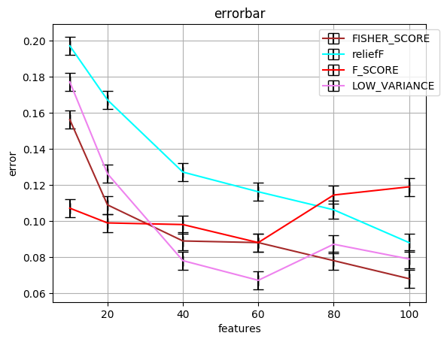
ERROR BARS OF FEATURE SELECTION ALGORITHMS
Error bar of feature selection algorithms using Random Forest classifier on Prostate Tumour dataset

Slide 44
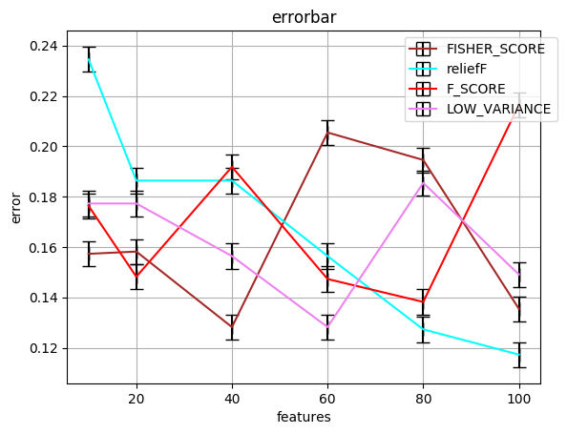
ERROR BARS OF FEATURE SELECTION ALGORITHMS
Error bar of feature selection algorithms using Decision Tree classifier on Prostate Tumour dataset

Slide 45
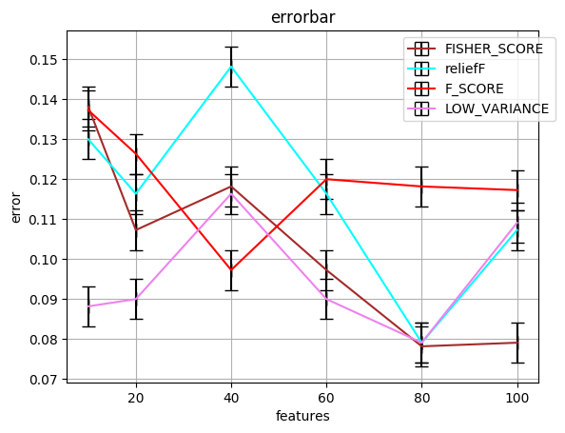
ERROR BARS OF FEATURE SELECTION ALGORITHMS
Error bar of feature selection algorithms using Bagging classifier on Prostate Tumour dataset

Slide 46
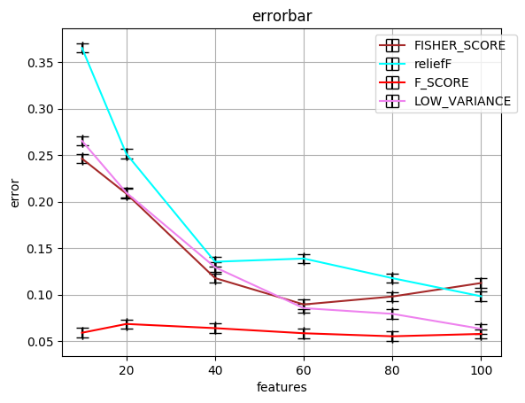
ERROR BARS OF FEATURE SELECTION ALGORITHMS
Error bar of feature selection algorithms using SVM classifier on Lung Cancer dataset

Slide 47
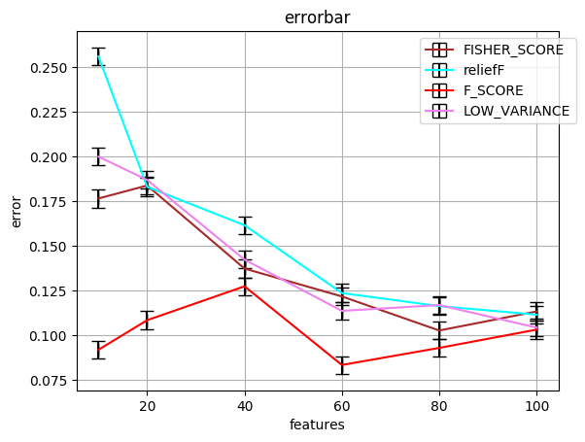
ERROR BARS OF FEATURE SELECTION ALGORITHMS
Error bar of feature selection algorithms using Random Forest classifier on Lung Cancer dataset

Slide 48
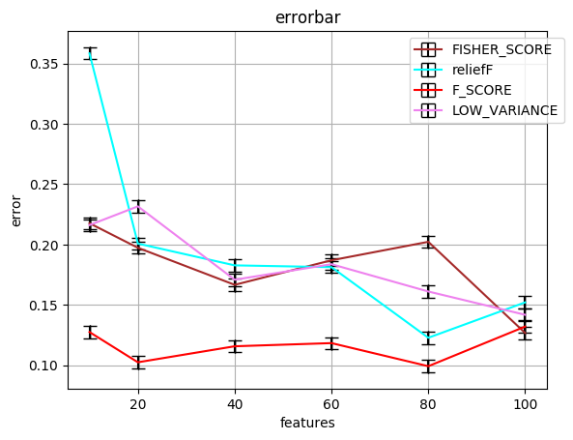
ERROR BARS OF FEATURE SELECTION ALGORITHMS
Error bar of feature selection algorithms using Decision Tree classifier on Lung Cancer dataset

Slide 49
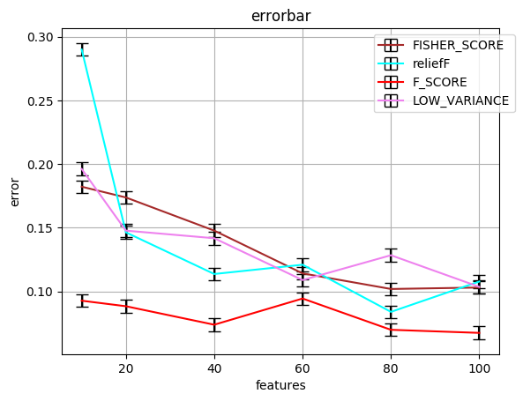
ERROR BARS OF FEATURE SELECTION ALGORITHMS
Error bar of feature selection algorithms using Bagging classifier on Lung Cancer dataset

Slide 50
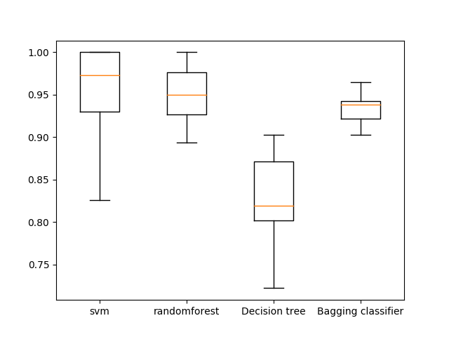
BOXPLOT OF DIFFERENT CLASSIFIERS
Boxplot of accuracy scores of different classifiers on SRBCT dataset

Slide 51
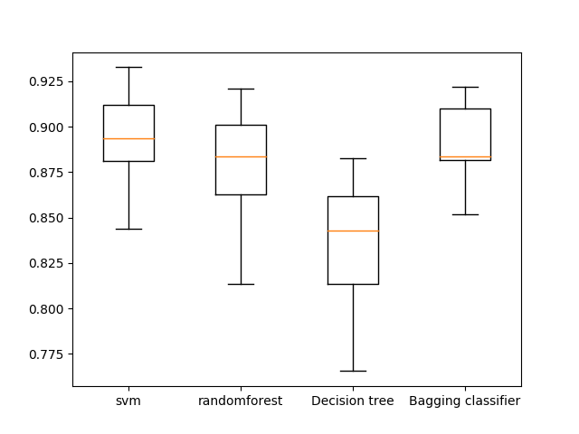
BOXPLOT OF DIFFERENT CLASSIFIERS
Boxplot of accuracy scores of different classifiers on Prostate Tumour dataset

Slide 52
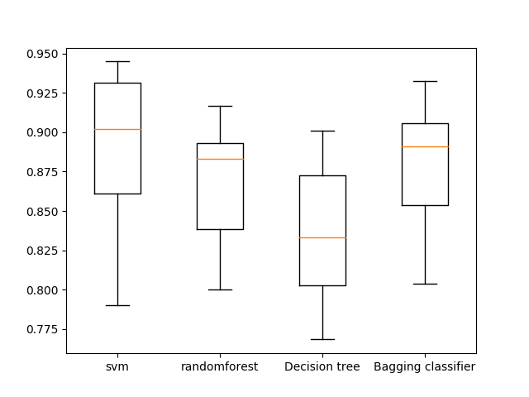
BOXPLOT OF DIFFERENT CLASSIFIERS
Boxplot of accuracy scores of different classifiers on Lung Cancer dataset

Slide 53
ACCURACY VALUES USING GENETIC ALGORITHM
 | SVM | Random Forest | Decision Tree | Bagging
Fold 1 | 1 | 0.9 | 0.9 | 0.8
Fold 2 | 1 | 1 | 1 | 1
Fold 3 | 1 | 1 | 0.666667 | 1
Fold 4 | 1 | 0.888889 | 0.777778 | 0.777778
Fold 5 | 1 | 1 | 0.888889 | 1
Fold 6 | 1 | 0.875 | 0.875 | 0.75
Fold 7 | 0.875 | 0.75 | 1 | 0.875
Fold 8 | 1 | 0.75 | 0.75 | 1
Fold 9 | 1 | 0.857143 | 1 | 0.857143
Fold 10 | 1 | 0.833333 | 0.833333 | 1
Average | 0.9875 | 0.8854362 | 0.8691667 | 0.9059921
Accuracy values of SRBCT dataset using Genetic Algorithm

Slide 54
ACCURACY VALUES USING GENETIC ALGORITHM
 | SVM | Random Forest | Decision Tree | Bagging
Fold 1 | 0.909091 | 0.818182 | 0.636364 | 0.909091
Fold 2 | 1 | 1 | 0.727273 | 0.909091
Fold 3 | 0.9 | 1 | 0.8 | 0.7
Fold 4 | 1 | 1 | 0.7 | 0.9
Fold 5 | 0.8 | 0.9 | 0.8 | 0.9
Fold 6 | 0.9 | 0.8 | 0.7 | 0.8
Fold 7 | 0.9 | 1 | 0.9 | 0.8
Fold 8 | 1 | 0.8 | 1 | 0.8
Fold 9 | 1 | 0.8 | 0.7 | 0.9
Fold 10 | 1 | 0.8 | 0.8 | 1
Average | 0.9409091 | 0.8918182 | 0.7763637 | 0.8618182
Accuracy values of Prostate Tumour dataset using Genetic Algorithm

Slide 55
ACCURACY VALUES USING GENETIC ALGORITHM
 | SVM | Random Forest | Decision Tree | Bagging
Fold 1 | 0.954545 | 1 | 0.863636 | 0.954545
Fold 2 | 0.904762 | 0.904762 | 0.857143 | 1
Fold 3 | 0.952381 | 0.857143 | 0.904762 | 0.857143
Fold 4 | 0.952381 | 0.857143 | 0.809524 | 0.809524
Fold 5 | 0.952381 | 1 | 0.904762 | 0.952381
Fold 6 | 1 | 0.904762 | 0.904762 | 0.809524
Fold 7 | 0.857143 | 0.952381 | 0.904762 | 0.904762
Fold 8 | 1 | 0.95 | 0.9 | 0.95
Fold 9 | 0.95 | 1 | 0.95 | 0.95
Fold 10 | 0.947368 | 0.842105 | 1 | 0.894737
Average | 0.9470961 | 0.9268295 | 0.8999350 | 0.9082615
Accuracy values of Lung Cancer dataset using Genetic Algorithm

Slide 56
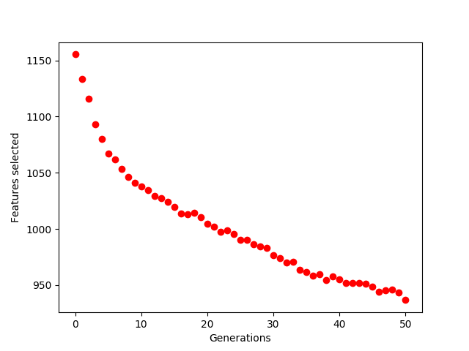
FEATURES SELECTED IN EACH GENERATION BY GENETIC ALGORITHM
Average number of features selected in each generation on SRBCT dataset

Slide 57
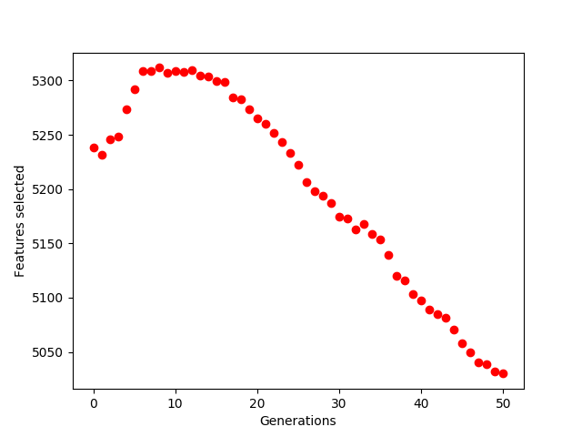
FEATURES SELECTED IN EACH GENERATION BY GENETIC ALGORITHM
Average number of features selected in each generation on Prostate Tumour dataset

Slide 58
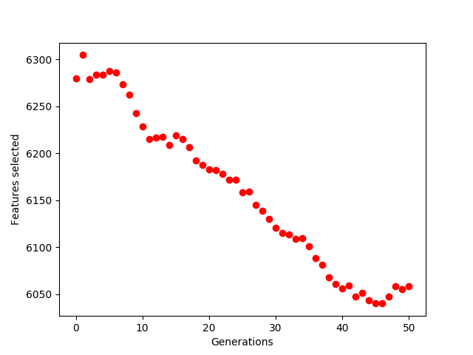
FEATURES SELECTED IN EACH GENERATION BY GENETIC ALGORITHM
Average number of features selected in each generation on Lung Cancer dataset

Slide 59
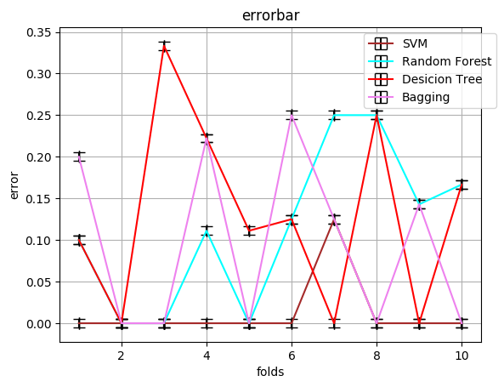
ERROR BARS OF GENETIC FEATURE SELECTION ALGORITHM
Error bar representing error on SRBCT dataset by different classifiers with Genetic Feature Selection

Slide 60
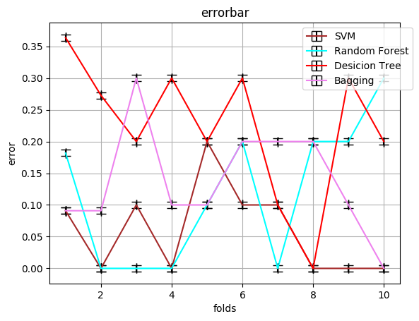
ERROR BARS OF GENETIC FEATURE SELECTION ALGORITHM
Error bar representing error on Prostate Tumour dataset by different classifiers with Genetic Feature selection

Slide 61
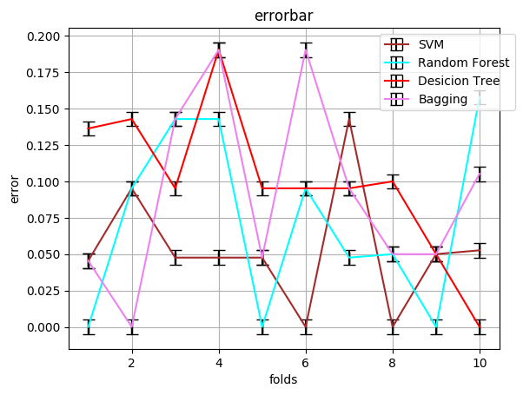
ERROR BARS OF GENETIC FEATURE SELECTION ALGORITHM
Error bar representing error on Lung Cancer dataset by different classifiers with Genetic Feature selection

Slide 62
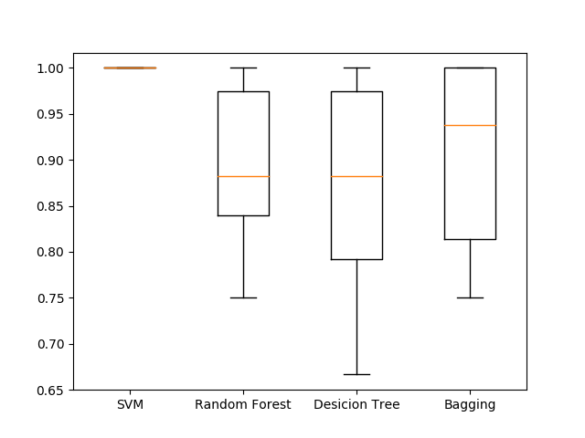
BOXPLOT OF DIFFERENT CLASSIFIERS USING GENETIC FEATURE SELECTION
Boxplot of accuracy scores of different classifiers on SRBCT dataset using Genetic Feature Selection Algorithm

Slide 63
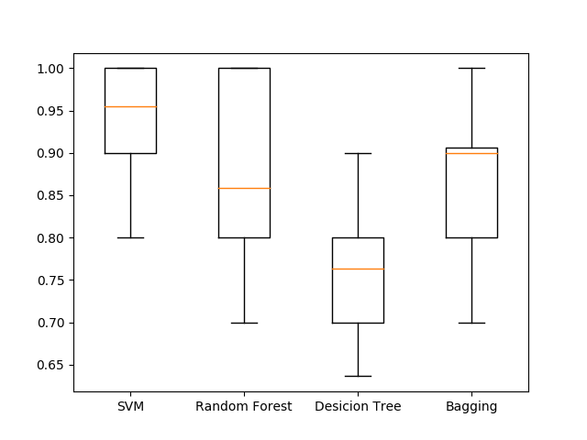
BOXPLOT OF DIFFERENT CLASSIFIERS USING GENETIC FEATURE SELECTION
Boxplot of accuracy scores of different classifiers on Prostate Tumour dataset using Genetic Feature Selection Algorithm

Slide 64
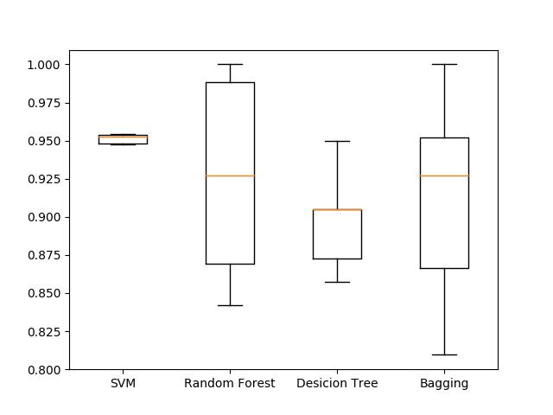
BOXPLOT OF DIFFERENT CLASSIFIERS USING GENETIC FEATURE SELECTION
Boxplot of accuracy scores of different classifiers on Lung Cancer dataset using Genetic Feature Selection Algorithm

Slide 65
CONCLUSION
Reduced the dimensionality problem & reduced over fitting problems when feature selection algorithms were applied. In SRBCT dataset there are 2309 features, when selected top 10, 20, 40, 60, 80, 100 the accuracy was greater than 80% in most of the cases. Likewise in lung cancer and prostate tumour dataset also there are 12601 and 10510 features respectively whose accuracy score was greater than 80% in most of the cases, which is acceptable.
Selecting top 100 features sometimes resulted in less accuracy and also took much time for computation. So, on selecting features using genetic algorithm on gene data the accuracy score was above 90% which is even better than feature selection algorithms. In this way the accuracy can be increased on datasets with high dimensionality but with less samples.

Slide 66
FUTURE WORK
In our project, we ran all the algorithms on our personal computer. To improve the time taken for computation we will run these algorithms in cloud machine and also combining feature selection algorithms with genetic algorithms result in hybrid algorithms which may increase the efficiency of classifiers. In future we try to implement this type of algorithms.

Slide 67
THANK YOU!!!

